Slide 1

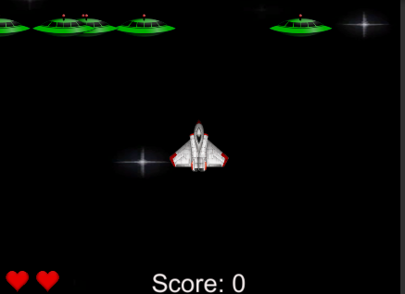
Sky shooter (myo edition)
Created By Keith Higgins and Aaron Healy

Slide 2
OUTLIne Of the project

Slide 3
OutLine
Reproduce a classic game or system using a gesture-based interface.
Develop an application with a Natural User Interface.
Use the MYO controller to replace a midi controller.

Slide 4

Technologys USED

Slide 5

Myo armband
Kinnect
Hollow lens
Leap motion controller

Slide 6

Unity 3d

Slide 7

Language
C#

Slide 8

Editor
Visual Studio code

Slide 9
WORK LOAD
Keith
Aaron
Myo Setup Redevelopment
Myo Controls Testing
Presentation Music
Video Documentation

Slide 10
PROGRESS

Slide 11

Design
Game Choice – Redevelop Sky Shooter
Language choice – C#
Gesture Choices (controls)
Time Frame: 2 Weeks

Slide 12

Implementation
Implement the game mechanics.
Implement the game controls.
fine tune the perfect gesture based user interface.
TIME FRAME: 2 Months

Slide 13
User Gestures

Slide 14
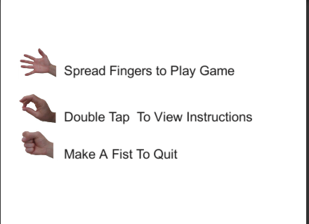
Gestures

Slide 15
GamePlay Gestures
Wave in – Move left
Wave out – move right
Fist - shoot

Slide 16
Issues

Slide 17

Issues
Myo is sometimes inaccurate.
Myo has high latency issues.

Slide 18
Future Additions
Pause Menu
Improved Controls
More Levels

Slide 19
Demonstration

Slide 20
